Slide 1

Week 3: XAML Components
Introducing Different Types of Available Components

Slide 2

Recap
Revision on XAML Layouts

Slide 3

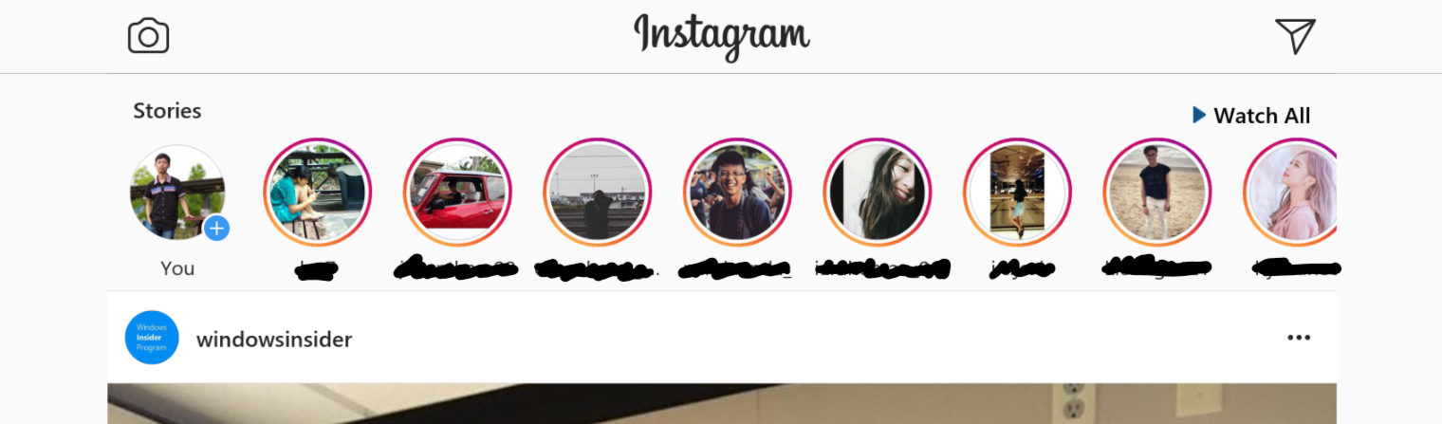
Design the Layout
Use your creativity and try to figure out the layout design!
StackPanel
GridView
ScrollViewer

Slide 4
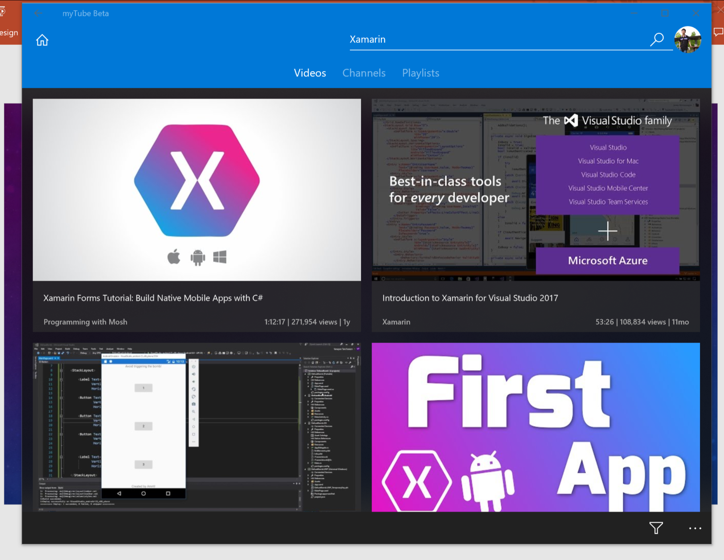
Design The Layout!
Use your creativity and try to figure out the layout design!
StackPanel
Grid
ScrollViewer

Slide 5
Declaring a Component
How To

Slide 6
Example
<TextBox Name="SomeTextBox"
HorizontalAlignment="Center"
Margin="10, 5, 10, 5">
<TextBox.Background>
<SolidColorBrush Color="Blue"/>
</TextBox.Background>
</TextBox>
Notes:
Explain the properties

Slide 7
Basic Components
Core Frequent Used Components

Slide 8
TextBlock
The main usage of the component is just to show text.
Appears almost everywhere in the app where text exists.
How to use this easily:
<TextBlock Text=“Your Message Here”/>

Slide 9
TextBox
Allows user to type in text.
Especially useful when typing input is required from the user by the program.
How to use it easily:
<TextBox Text=“”/>
The input text would be binded to the Text property

Slide 10
Button
Just a button, as the name mentioned.
Useful when mouse click input is required from the user.
How to use it easily:
<Button Content=“Button Text” Click=“ClickFunctionName”/>
Content property indicates what should show in the button, can be a simple “OK” or some other XAML components.
Click is an event, where the function inside will be called when button is clicked. More information will be covered in next class (2 weeks later)

Slide 11
Image
Shows a picture file.
Useful when showing information in image form. (No one wants an app with just plain text, right?)
How to use it easily:
<Image Source=“ImageFolderInProject/ImageFile.png”/>

Slide 12
CheckBox
Allows user to “tick” or “untick” an option.
Useful in places where multiple options are available.
How to use it easily:
<CheckBox IsChecked=“false”>Your message here</CheckBox>
The status of the CheckBox (checked/not checked) is binded to the IsChecked property.

Slide 13
ComboBox
Allows user to select an item from list.
Useful when users are required to choose only one option from a few.
How to use it easily:
<ComboBox>
<ComboBox.Item>
<ComboBoxItem>Option 1</ComboBoxItem>
<ComboBoxItem>Option 2</ComboBoxItem>
<ComboBoxItem>Option 3</ComboBoxItem>
</ComboBox.Item>
</ComboBox>
The selected value is binded to the SelectedItem property

Slide 14
Slider
Allows user to set a value using a sliding bar.
Useful when the value input from user requires some accuracy.
How to use it easily:
<Slider Maximum=“100” TickFrequency=“1”/>
The result is binded to the Value property

Slide 15
WebBrowser
Shows webpages
Can be useful when certain actions are required to performed with a webpage, or just to show web contents
Browser type depends on what platform you develop for, in this case is Internet Explorer ☹
How to use this easily:
<WebBrowser Source=http://www.example.com/ />
Source is the target website for the WebBrowser

Slide 16
And… really much more.
There’s a lot of native predefined components provided in XAML, which we can’t cover all.
Do try out Google and StackOverflow if you want to know more!

Slide 17
Quick Recap
Summarize What You Just Learnt.

Slide 18
What Is This Component?
TextBlock
Image
TextBox
ComboBox

Slide 19
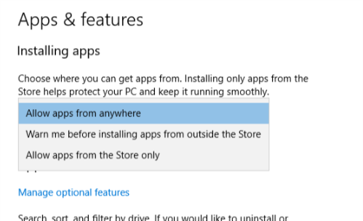
What is This Component?
TextBox
Button
Slider
ComboBox

Slide 20
Choose A Suitable Component
A pizzeria wants to allow user to choose different types of toppings when user orders pizza using their app. Which component suits the purpose the most?
(Example: User A can choose a pizza with pineapple and chicken toppings while User B can choose a pizza with sausage only topping)
ComboBox
CheckBox
Slider
ProgressBar

Slide 21
Practical Session
Get Your Hands Dirty With What you Just Learnt!

Slide 22
Coming Up Next Week…
It’s a mystery this time, come to the class next week to check out more! 😉

Slide 23
More Layouts
More Type of Layouts

Slide 24
ListView

Slide 25
GridView

